Slide 1
WELCOME TO OUR PRESENTATION

Slide 2
PRESENTATION TOPIC
Snake game in a box

Slide 3
Group Members
Syed Nazmul Bin Nazrul- 141-15-3225
Rahnuma Islam- 141-15-3142
Maria-Tuz-Jannah- 141-15-3191

Slide 4
Snake game
What is a snake game?
A snake game is a game that has a boundary within which there is a snake. The snake is moved around by the arrow keys and moved towards a fruit. Main process is to make the snake eat the fruit. Each fruit it eats gives points. As the snake keeps eating the fruit it gets bigger in length. It’s length increases but the boundary remains the same. So along with making the snake eat the fruit player must make sure the snake doesn’t touches the boundary, because if it touches the boundary the game will be over.
Snake game and our project:
Our project is to make the snake game using assembly language. As we know assembly language is not a very advanced language but it is possible to make this game using assembly language. To make this game we had to use mostly the stack and jump instruction. There are many loops in the code for making the boundary, to relocate the fruit, move the snake etc. as there are no direct loops in assembly coding we made the loops using conditional jump. The code for this program is given below. In the code comments in each line specify the work that is being done by that line.

Slide 5
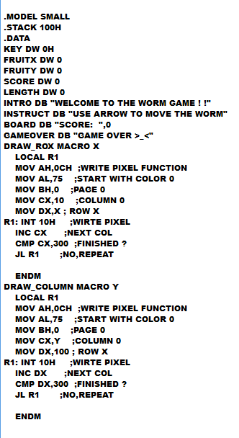
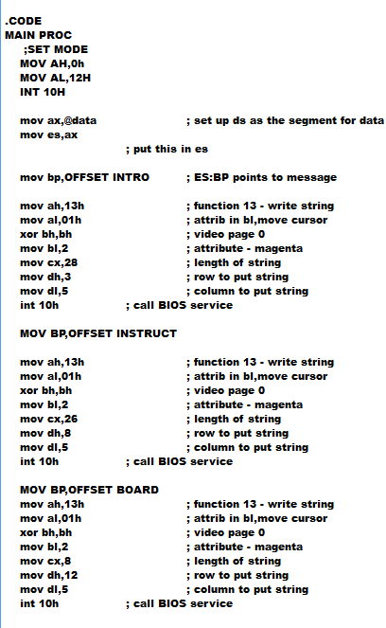
Code

Slide 6
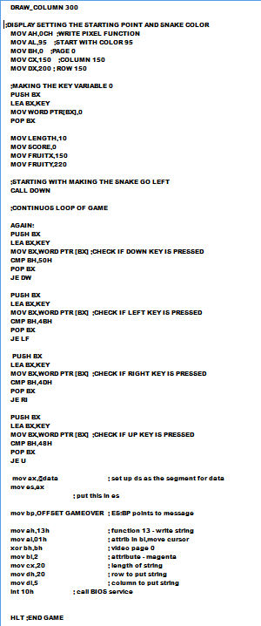
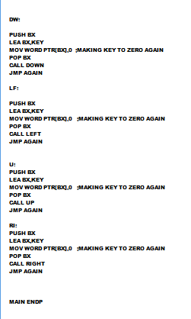
Code

Slide 7
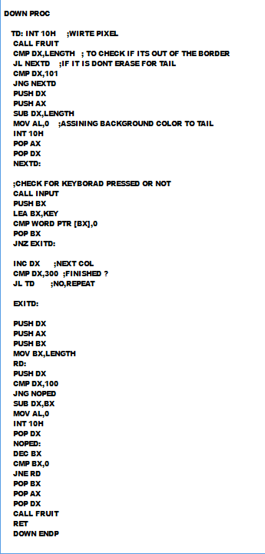
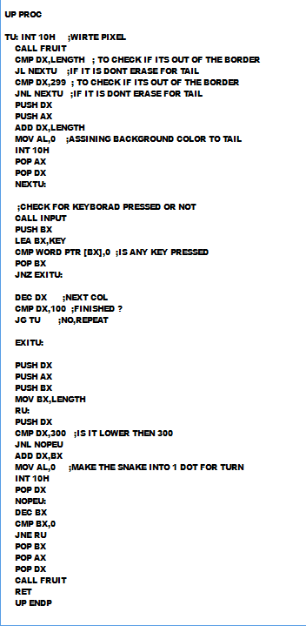
Code

Slide 8
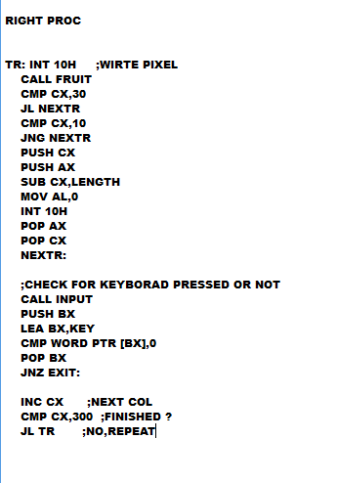
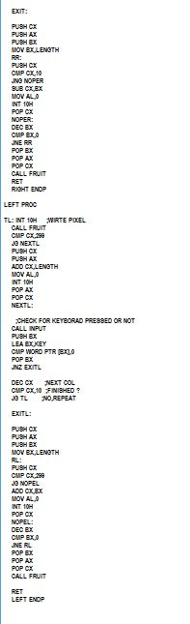

Slide 9
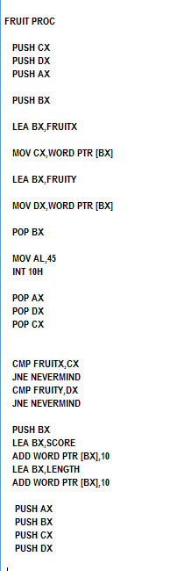
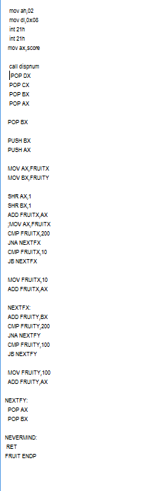

Slide 10
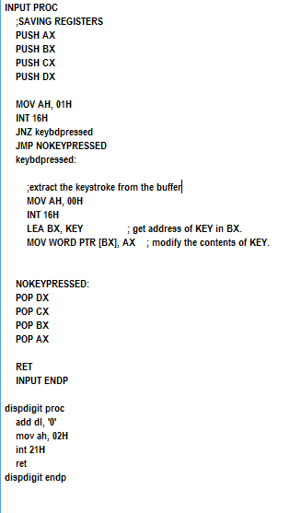
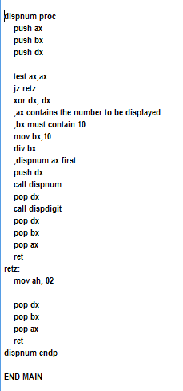

Slide 11
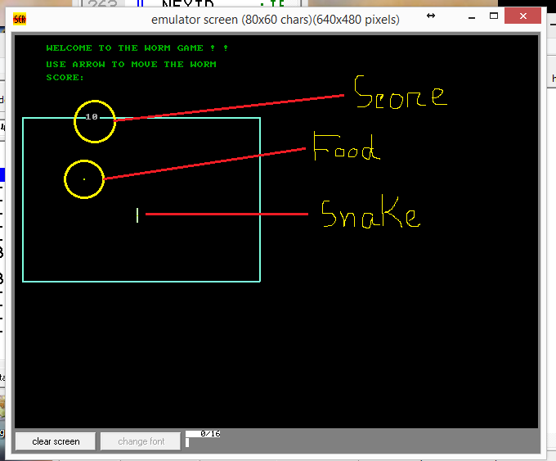
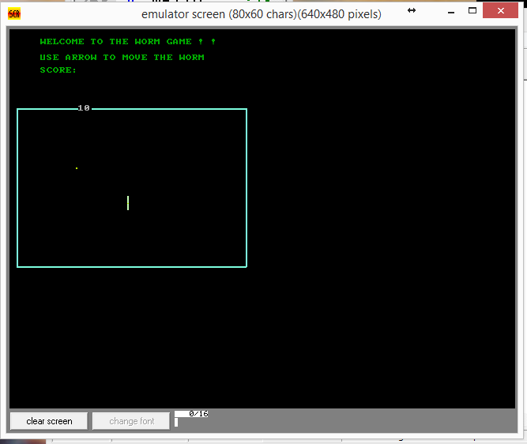
Output

Slide 12
THANK YOU

